Slide 1
Comparison between speech-input and text-input user interfaces for health CENTERS
Fall 2021 cng 2542 human computer interaction
Eugene owilla 2528933
Abdullah sulayfani 2542603

Slide 2
introduction
Computerised systems used in health centres
Traditional user interfaces for health centres – text input
Our traditional user interface – QTracker
Domain – health centres
Actors – receptionists, doctors, patients
Tasks – filling forms, creating appointments, adding patients to queues

Slide 3
Related work [Ref. 1 - 6]
Text-input based user interfaces
Pros of text input methods – compact & robust to error
Speech input vs. speech interaction – differences
Pros of speech input – speed, robust to audience
Drawbacks of speech input
Speech input implementation in different contexts

Slide 4
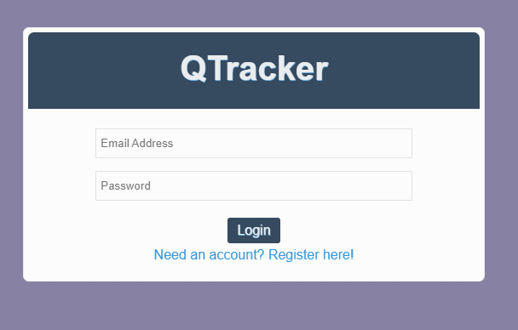
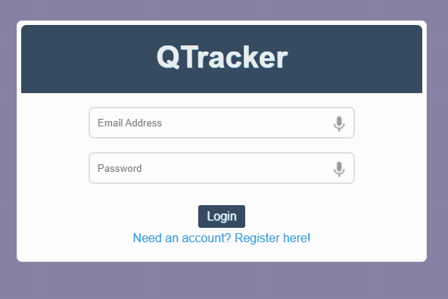
design
Old login interface before adding the microphones (left) vs the new one with microphones (right).

Slide 5
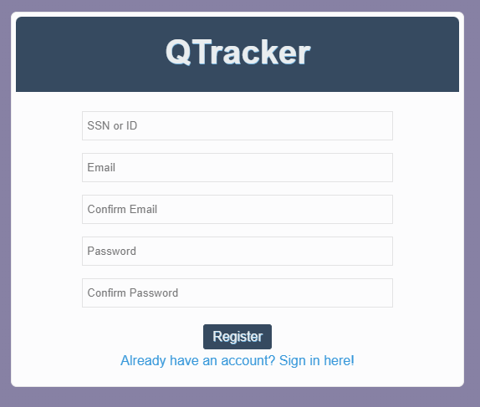
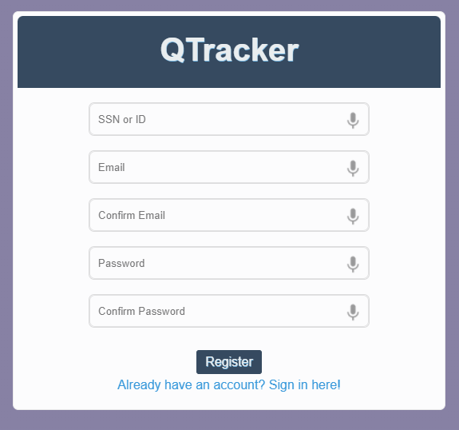
design
Old registration interface before adding the microphones (left) vs the new one with speech (right).

Slide 6
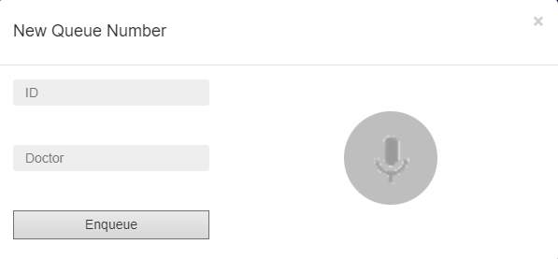
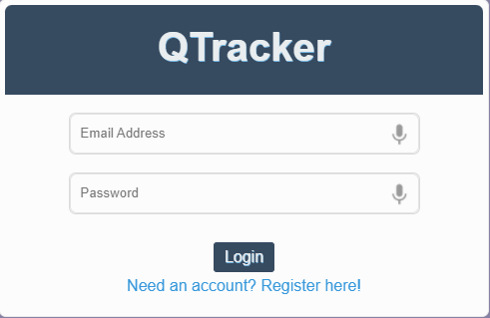
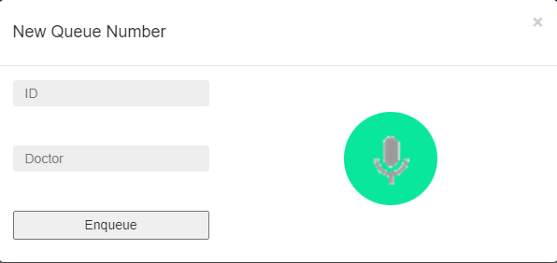
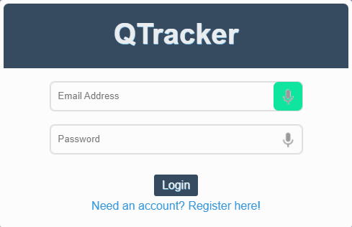
design
Microphones in their listening (green) and silent (grey) states.

Slide 7

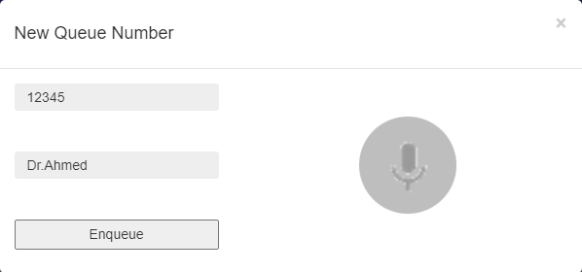
implementation
More input structure freedom
Easily perform adjustments
Technologies used – JavaScript, JQuery

Slide 8
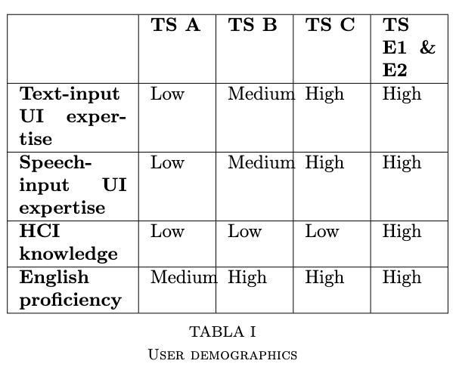
Evaluation methodology 1
User-based evaluation – questionnaire from SUS [7] + 5-point Likert Scale
Why?
Did the questions satisfy the guidelines for “good” questions?
Demographic details of the test subjects used.

Slide 9
Evaluation methodology 1
Questions from questionnaire – focus of UX
I think that I would like to use this system frequently
I found the system unnecessarily complex.
I thought the system was easy to use.
I think that I would need the support of a technical person to be able to use this system.
I found the various functions in this system were well integrated.
I thought there was too much inconsistency in this system.
I would imagine that most people would learn to use this system very quickly.
I found the system very cumbersome to use.
I felt very confident using the system.
I needed to learn a lot of things before I could get going with this system.
System Usability Scale, https://www.usability.gov/how-to-and-tools/methods/system-usability-scale.html

Slide 10
Evaluation methodology 2
Expert-based evaluation – heuristic evaluation + yes/no scale
Expert evaluators – the developers of the system
10 design heuristics by Nielsen Norman Group [8]
Expert reports written

Slide 11
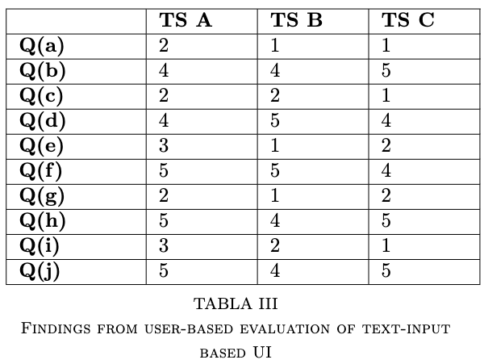
Results 1.1 - user evaluation
User-based evaluation – responses from test subjects after using the text input user interface.
Likert scale [1 - ‘Strongly Agree’, 2 - ‘Agree’, 3 - ‘Neutral’, 4 - ‘Disagree’, 5 - ‘Strongly Disagree’].

Slide 12
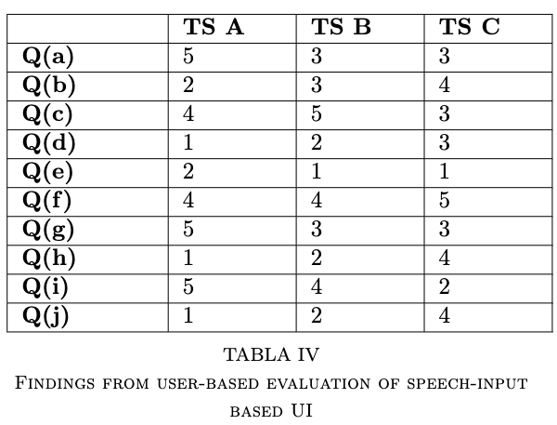
Results 1.2 – user evaluation
User-based evaluation – responses from test subjects after using the speech input user interface.
Likert scale [1 - ‘Strongly Agree’, 2 - ‘Agree’, 3 - ‘Neutral’, 4 - ‘Disagree’, 5 - ‘Strongly Disagree’].

Slide 13
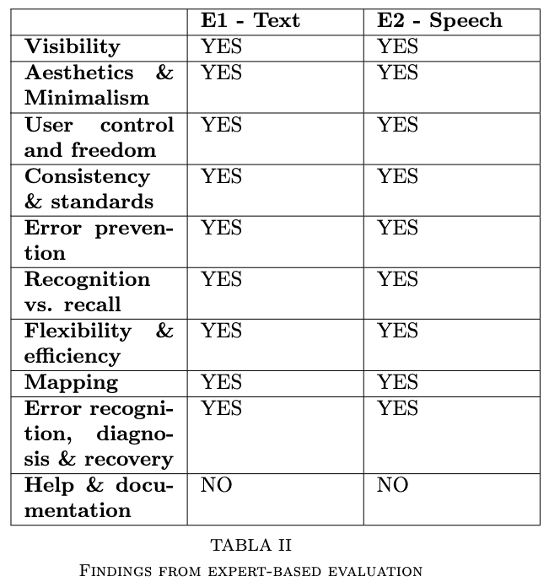
Results 2 – expert evaluation
Results from heuristic evaluation by experts.
Reports written by expert evaluators

Slide 14
discussion
User-based evaluation – speech input interface functions well but in this context, the text input interface is PREFERRED.
Expert-based evaluation – a user interface could clear a checklist but still be inappropriate because of the implementation context.
Existence of alternative interaction modes affects perceived usability.

Slide 15
conclusion
There is no clear-cut conclusion as to which interaction mode is better - implementation should depend on the context.
Domain/Environmental analysis needs to be done before designing a user interface.
Deployment domain and environment need to be accounted for in evaluation of user interfaces.

Slide 16
references
1. Advantages of Voice User Interfaces, https://www.speechly.com/blog/advantages-of-voice-user-interfaces/ 2. Speech Input, https://wunder.io/wunderpedia/accessibility/digital-assistive-technologies/speech-input/ 3. The State of Speech in HCI: Trends, Themes and Challenges, Leigh Clark¹, Phillip Doyle¹, Diego Garaialde¹, Emer Gilmartin², Stephan Schlogl³, Jens Edlund⁴, Matthew Aylett⁵, Joao Cabral⁶, Cosmin Munteanu⁷, Benjamin Cowan¹, ¹School of Information and Communication Studies, University College Dublin, Ireland, ²Speech Communication Laboratory, Trinity College Dublin, Ireland, ³MCI Management Center, Innsbruck, Austria,⁴Department of Speech, Music and Hearing, KTH Royal Institute of Technology, Sweden, ⁵School of Informatics, University of Edinburgh, United Kingdom, ⁶School of Computer Science and Statistics, Trinity College Dublin, Ireland, ⁷Institute of Communication, Culture, Information and Technology, University of Toronto, Mississauga, Canada 4. Speech recognition in the human-computer interface, Carl M. Rebman Jr, Milam W. Aiken, Casey G. Cegielski 5. The role of voice input for human-machine communication, Philip R. Cohen, Sharon L. Oviatt ”Human-Machine Communication by Voice,.” colloquium organized by Lawrence R. Rabiner, National Academy of Sciences, The Arnold and Mabel Beckman Center in Irving, CA, February 8-9, 1993. 6. The limits of speech recognition, Ben Shneiderman Communications of the ACM, Volume 43, Number 9 (2000), Pages 63-65 7. System Usability Scale, https://www.usability.gov/how-to-and-tools/methods/system-usability-scale.html 8. 10 Usability Heuristics for User Interface Design, https://www.nngroup.com/articles/ten-usability-heuristics/

